Slide 1
MAR 580: Advanced Population Modeling for Management of Living Marine Resources
Lecture 1
Introduction
04 September 2025

Slide 2
Outline
Class Logistics, Introductions
Applications of quantitative methods for scientific advice for fisheries management – class ‘fit’
Likelihood Review, Numerical Methods I

Slide 3


Slide 4
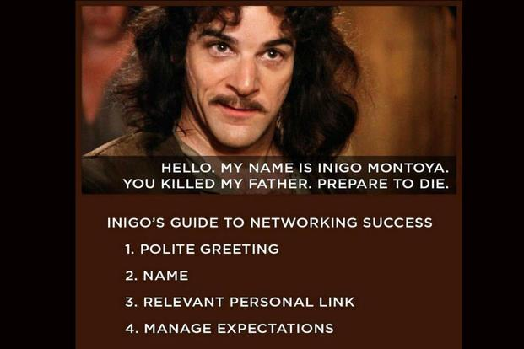
Introductions

Slide 5
Introductions
“Hello. My name is ____________ . I study _________ . I am interested in this class because _______ .
If I could choose a superpower, it would be ____________ .”

Slide 6

Community Guidelines
Co-create our expectations for our interactions this semester
University policies & regulations apply
Fay lab & SMAST code of conduct

Slide 7

Course Description
Instruction, demonstration and exercises in advanced population modeling, as applied to management of living natural resources.
Principles of statistical inference and process-based model building recognizing uncertainty.
Range of population assessment methods will be developed through statistical programming and applied to fisheries and marine mammal data sets to fit complex nonlinear models by estimating values for parameters and associated uncertainty.
State of the art programming software for implementing these models.
Course is designed to train students to “have the ability to conduct high-quality scientific research in stock assessment, fishery population dynamics and related fields”

Slide 8
Course objectives
Ability to apply principles underlying process- based model building
Familiarity with advanced stock assessment models and their implementation
Experience in model building and parameter estimation
Understanding of quantitative theories, model diagnostics and results

Slide 9
Overview of schedule
Switch to syllabus

Slide 10
Course Role
Department of Fisheries Oceanography Quantitative Curriculum
Quantitative Methods (Cowles)
Biological Statistics 1 & 2 (Kozak, Fay)
Numerical Methods (Chen)
Stock Assessment (Cadrin)
Advanced Population Modeling (Fay)
Bayesian Statistics & Hierarchical Modeling (Fay)
Models for Ecosystem-Based Management (Fay)
Biotelemetry (Brewster)

Slide 11
Instructor contact information
Gavin Fay
gfay@umassd.edu
508-910-6363
SMAST-E Rm 228

Slide 12
Course mechanics: Format
Each week:
Tue & Th: Lecture/Lab SMAST E-247 2:00-3:30
Student hours:
Mon 1:00-2:00
Tue/Thu 3:30-4:30

Slide 13
Course materials
Course website & GitHub repository
Rstudio Cloud
MAR580 Google Doc
Syllabus
Lecture materials
Readings
Data files, scripts, etc.
Recordings

Slide 14
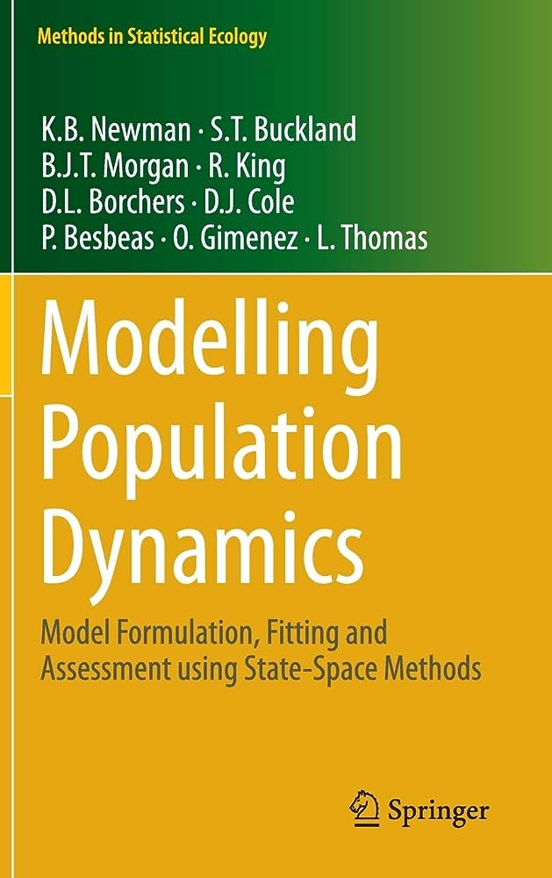
Text

Slide 15
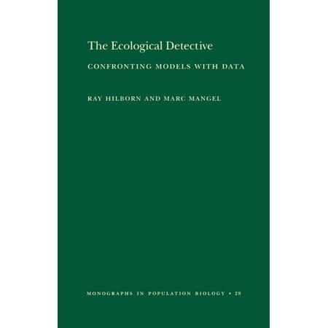
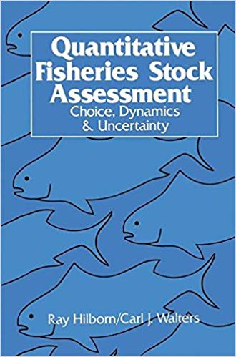
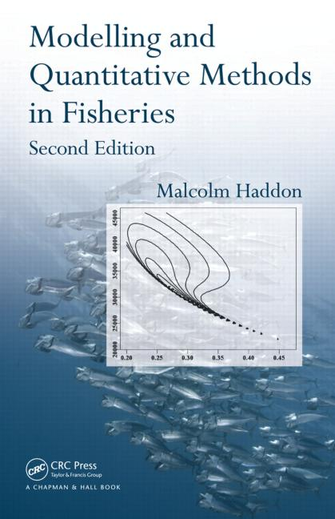
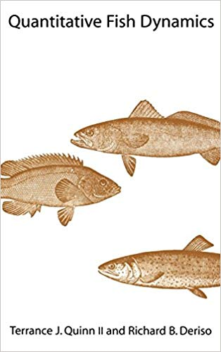
Books for background reading

Slide 16
Course mechanics: Evaluation
Four homework assignments (70%)
Small research project (20%)
Participation (10%)
Campus Academic Policies & Student Resources linked on syllabus

Slide 17
Project ideas
“incorporate time-varying and/or spatially-varying environmental covariates and its effects on reference point estimation and projections”
“interested in exploring how environmental factors (like temperature or oxygen levels) can be incorporated into population projections or recruitment models.” “testing the sensitivity of a population model to different climate scenarios” “I'd love to make progress on some dissertation work with WHAM projections assumptions for groundfish”
“I have a state-space model I need to make progress on.”
Paused Projections research track Terms of Reference
Mixed fisheries projection analyses (FLBEIA and similar)
Fit and diagnose a population assessment model to candidate data (e.g. new application, or move a stock to modern software / model, test robustness to different data / model assumptions, etc.)
Scup assessment into WHAM
Scallops in Stock Synthesis
Apply Multispecies age-structured model for Northeast (extend work already begun in CEATTLE)

Slide 18


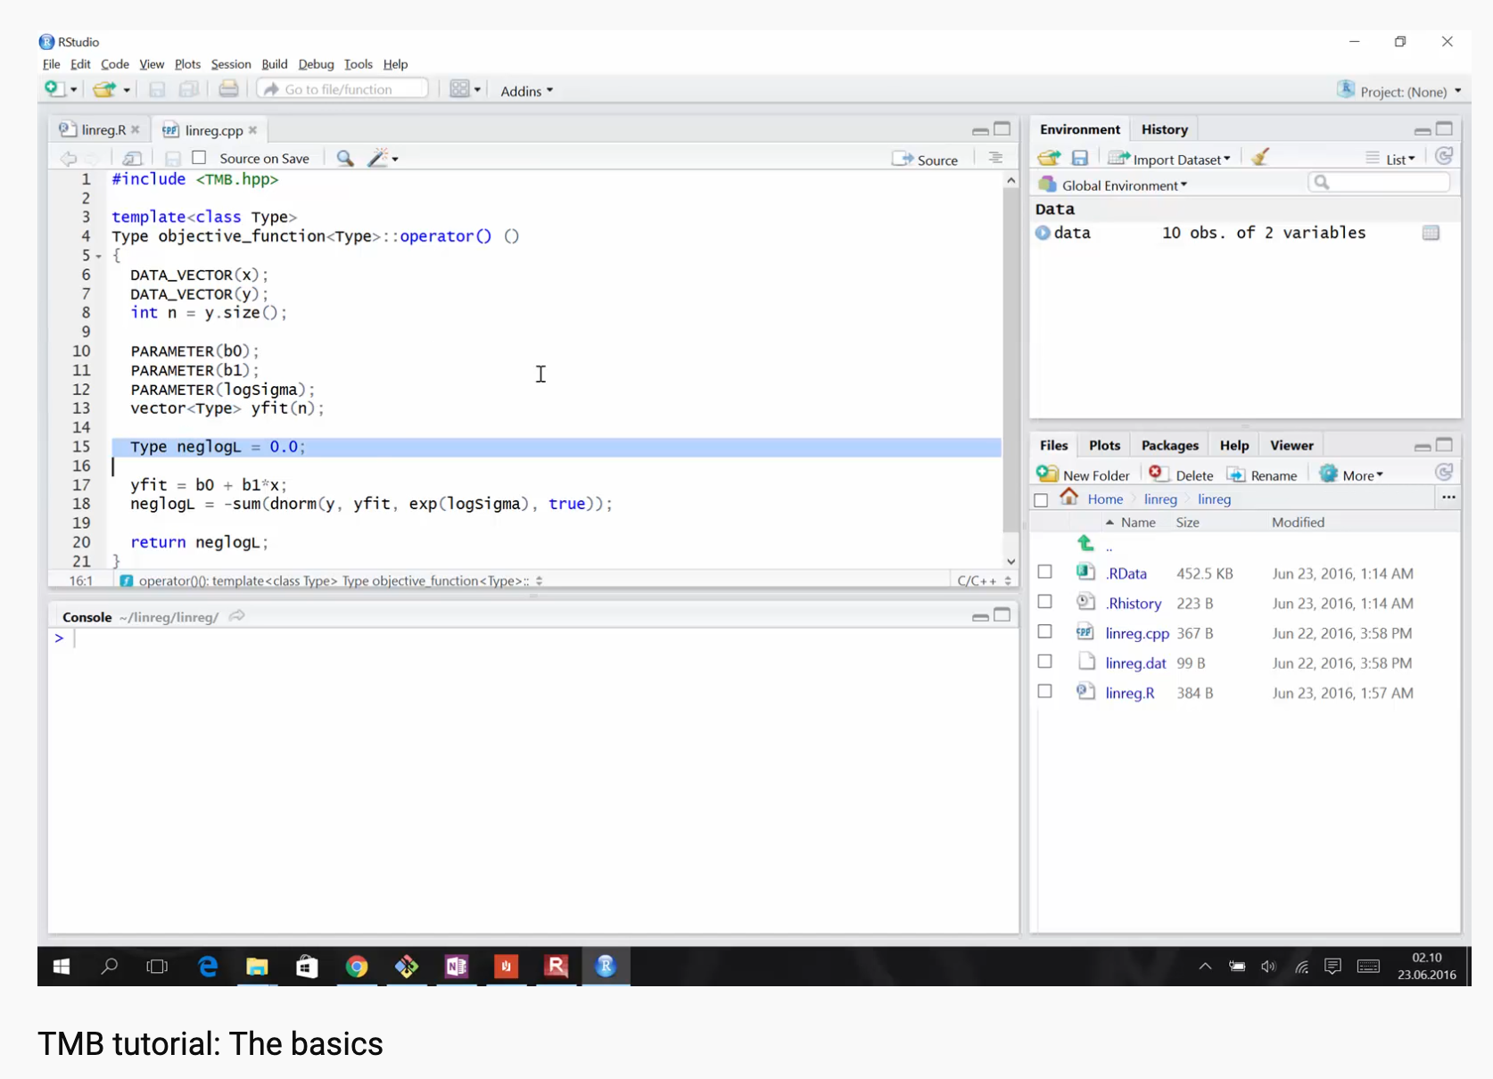
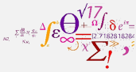
Software
R
Template Model Builder (TMB)

Slide 19
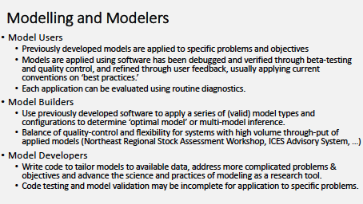
(from Cadrin)

Slide 20
Use of population models in fisheries and conservation
How many are there?
Estimating extinction risk.
How many can we harvest?
System relationships and dynamics
ecological
economic
How well are hypotheses supported by data?
What is the uncertainty in our estimates?
Designing monitoring programs
Comparing among policy options

Slide 21
Use of population models in fisheries and conservation
How many are there?
Estimating extinction risk.
How many can we harvest?
System relationships and dynamics
ecological
economic
How well are hypotheses supported by data?
What is the uncertainty in our estimates?
Designing monitoring programs
Comparing among policy options
“Stock assessment”

Slide 22
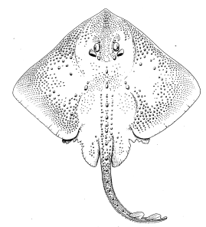
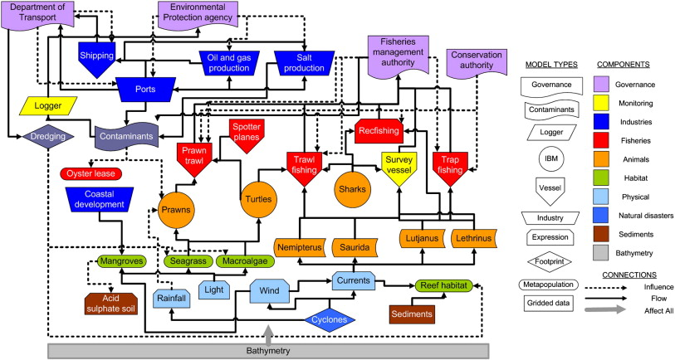
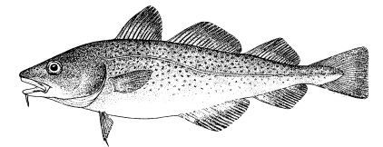
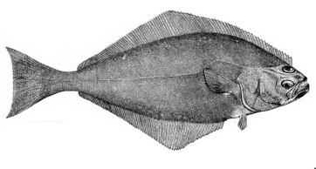
Gradient of tools and uses
Stock/Single Species
Multi-species
Aggregate Biomass
Ecosystem
Gadids
Pelagics
Flatfish
Single species models
food web models
Multi-species assessments
Extended single species models with predation mortality, habitat or climate effects
Whole of system models
Aggregate Biomass Models
Multiple single species assessments in “harmony”

Slide 23
Stock Assessment Models (the bread & butter)
Index-based methods
Equilibrium & Generation methods
Yield-Per-Recruit / Stock-Recruitment
Population dynamics models
Biomass aggregated models
e.g. production models
Stage-Structured models
Delay difference models
Age structured models
virtual population analysis, statistical catch-at-age
Size-based models

Slide 24
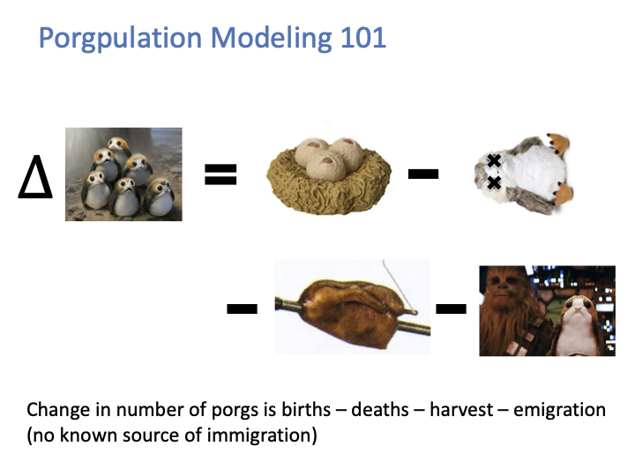

Slide 25
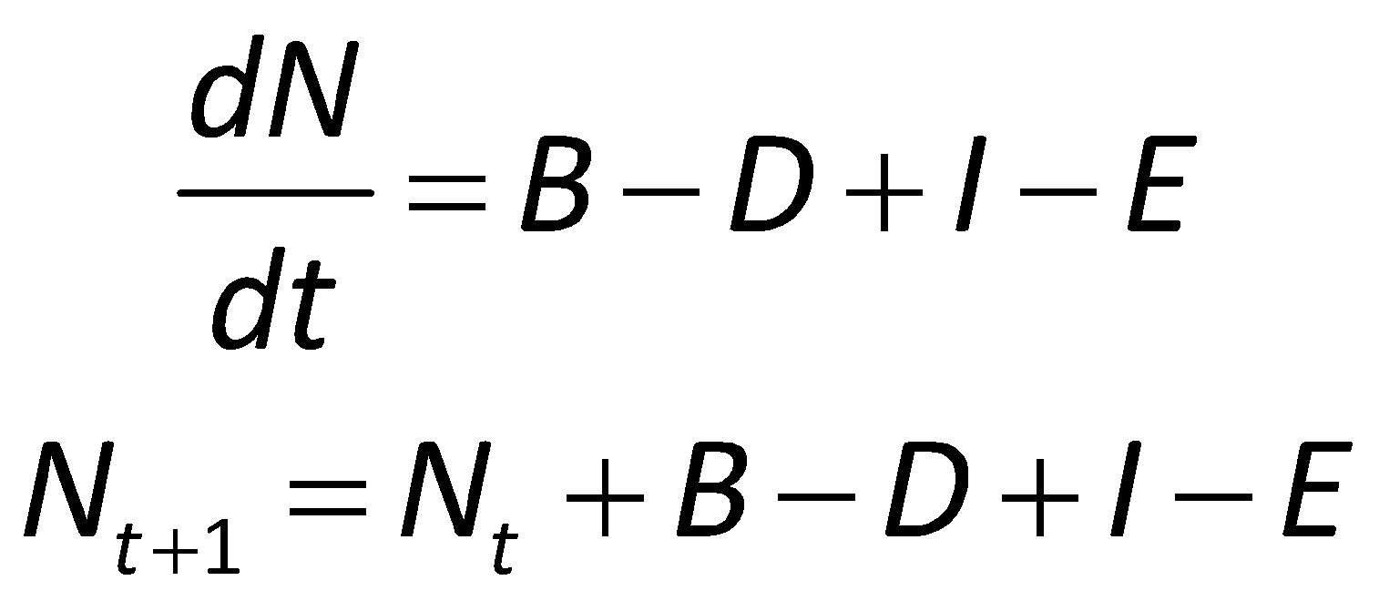
All you ever need to know for Population Modeling
Numbers next year = numbers this year + births
– deaths + immigrants – emigrants
Notes:
Simple, yet comprehensive.
Major processes are implied, but not often explicitly parameterized.
Terms can be added to incorporate the appropriate level of explicitness for each process.
N can be a species, a stock, a guild, an aggregate, etc.

